Slide 1
Introductory slides for trauma informed practice
Open, Fairer, Greener
Contents
The BNSSG pledge to become a trauma informed system and network of services
A system transformation
Our existing strategic commitment key documents
BNSSG definition of trauma informed practice (TIP)
Work priorities for 24/25
TIP principles to inform our services, policies and practices (definitions are found in the BNSSG framework)
Description of the journey to become trauma informed – the 4 stages
BNSSG Practice Framework (an overview)
Our overarching long-term objectives
How to get involved
Accompanying documents
V1 July 2024 it will be updated as the programme progresses

Slide 2
Open, Fairer, Greener
Bristol, North Somerset South Gloucestershire (BNSSG) Pledge
9th May 2024 the Executive and Corporate Leadership Team signed a pledge to implement a trauma informed approach across North Somerset as part of a wider BNSSG strategy to create a trauma informed system.
Our 2 priorities for 24/25
-Training
-Coproduction

Slide 3
Systems Approach
Open, Fairer, Greener
A whole system approach - meaningful to communities, service users and staff. Not about a single intervention but a fundamental shift in the way services are developed, delivered and experienced.
A process of organisational change aiming to create a culture, environments and relationships that promote recovery and prevent re-traumatisation.
Focus on prevention (understanding and minimising risk of experiencing trauma and adversity) and early intervention (recognising early where an individual, family or a community is experiencing trauma in order to respond and support when needed, not once more serious issues occur).
System change takes time. Our aspiration should be that our approach is consistent and long lasting, not a tick box exercise.

Slide 4
Relevant strategies
Open, Fairer, Greener
Corporate Strategy 2022-2024
Priority commitments: To protect the most vulnerable people in our communities and focus on tackling inequalities, improving outcomes (p16)
Annual Directorate Statements 2024/2025
Ambition 1. Our children and young people are cared for, safe, supported and given equality of opportunity to thrive.
Mental Health Strategy 2025 (in development)
Health and Wellbeing Strategy 2025 (in development)

Slide 5
Relevant strategies
Open, Fairer, Greener
Children's Social Services Practice framework
Our overarching approach to practice is strengths and relationship based and is trauma informed with the complimentary approach of Signs of Safety. (p3)
Adults Social Services Practice framework
Key approaches – Trauma Informed Practice/Coproduction/Strengths Based Practice/Anti-racist and Anti-discriminatory Practice/Relationship-Based Practice/Person-centred practice/Positive Risk Taking/Evidence Informed Practice/Compassionate Leadership/Critically Reflective Practice/Human Rights Based Approach
Early Years Strategy 2023-2026
‘Our Vision Create a deep sense of belonging for every child that is built upon feeling understood, nurtured, accepted, and respected. Across the early years sector, a robust knowledge of child development, trauma-informed practice and nurture theory will underpin this strategy.’
Youth Justice Partnership Plan 2021-2024

Slide 6
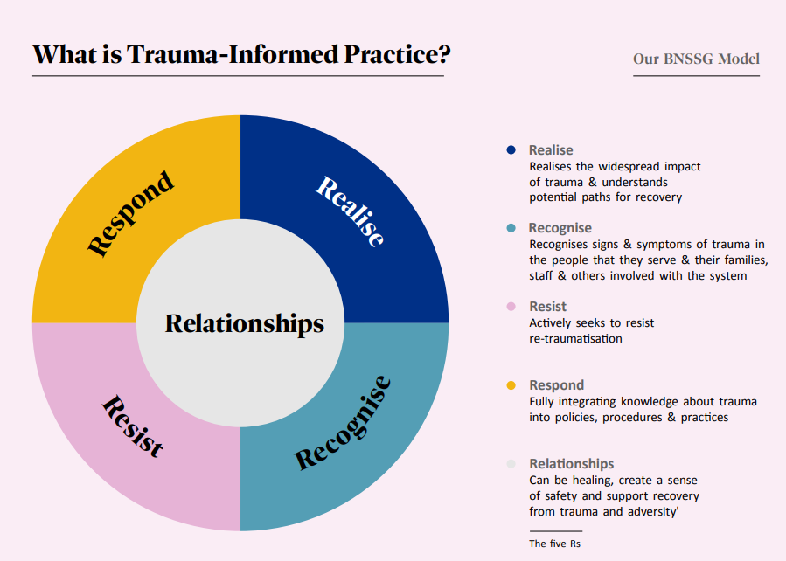
Definition and Priorities
Open, Fairer, Greener
Priorities 24/25
a. Co-production
Work plan
Training programme
Ambassador network
Mapping
Evaluation
Pledge - cultivating strategic commitment
Notes:
There is a steering group with representatives from health, social care, the voluntary sector, etc who will support and oversee the work of the trauma informed practice officer claire Ritchie.

Slide 7
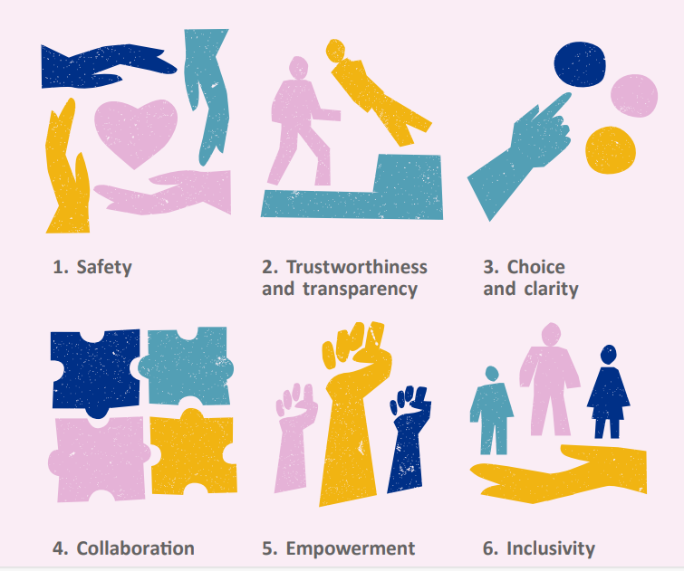
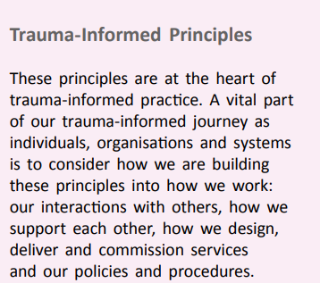
The Principles
Open, Fairer, Greener
Notes:
These are the principle we want to embed in all of our services (what they mean is included in the framework)– how we do this will be dependant on the service provided and should be co-produced with service users.

Slide 8
Practice Framework
Open, Fairer, Greener
Notes:
BNSSG describe the process as a journey from trauma aware to trauma responsive
BNSSG Trauma-Informed Practice Framework.pdf includes the values and principles of TIC, a glossary of terms and a useful self-assessment questionnaire

Slide 9
Open, Fairer, Greener

Slide 10
Our Aspirations
Open, Fairer, Greener
Overarching objectives and long-term outcomes
To protect the most vulnerable people in our communities and focus on tackling inequalities, improving outcomes
1. Reduced health inequalities: increased, sustained, engagement from people currently under-represented in our services.
2. Trauma Informed System: evidenced in our behaviour, language, strategies, policies and practice.
3. An emotionally healthy workforce, supported and confident in implementing the approach.
4. Impact data and evaluation report 2026/27 with recommendations for sustainability.
Notes:
Aligned with council values and priorities

Slide 11
Open, Fairer, Greener
How to get involved
Support and champion our aspiration to be a trauma informed system, across North Somerset and BNSSG
Cultivate operational and strategic buy-in within your organisation, services, teams and directorates to create an even bigger system change
Become an ambassador please contact the TIP Officer claire.Ritchie@n-somerset.gov.uk

Slide 12
Resources
FAQ Ambassadors
BNSSG pledge
BNSSG pledge briefing
BNSSG Trauma-Informed Practice Framework.pdf
follow links for more info and videos on NS Better Health website
You searched for trauma informed | Better Health North Somerset (betterhealthns.co.uk)
Trauma Informed Practice | Better Health North Somerset (betterhealthns.co.uk)

Slide 13
Open, Fairer, Greener

